Slide 2
Playing Versus Tetris with a Genetic Algorithm
Yap Wei Xiang
Supervisor:
Dr Richard Wong Teck Ken

Slide 3






Outline
Introduction
Motivation • Problem Statement • Aim • Objectives
Literature Review
Difficulty of Tetris • Playing Tetris with Genetic Algorithms
Methodology
Defining the Rules • Genetic Algorithm Implementation • Evaluating Gameplay
Results and Discussion
Genetic Algorithm Results • Evaluating Final Weight Vector
Conclusion
Limitations • Future Work
Demo
Game • Bot

Slide 4
Outline
Introduction
Motivation • Problem Statement • Aim • Objectives
NP-complete problems
Route Optimization [1]
Job Scheduling [2]
Medical Diagnosis [3]
Tetris [4]
Literature Review
Difficulty of Tetris • Playing Tetris with Genetic Algorithms
Methodology
Defining the Rules • Genetic Algorithm Implementation • Evaluating Gameplay
Results and Discussion
Genetic Algorithm Results • Evaluating Final Weight Vector
Conclusion
Limitations • Future Work
Demo
Game • Bot

Slide 5
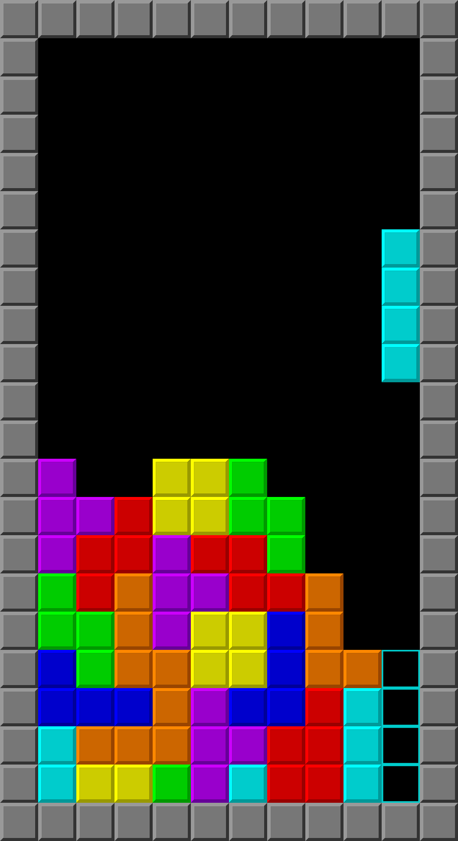
Outline
Introduction
Motivation • Problem Statement • Aim • Objectives
Research has shown the effectiveness of nature-inspired algorithms such as the genetic algorithm in playing the game of Tetris [5, 6].
Literature Review
Difficulty of Tetris • Playing Tetris with Genetic Algorithms
Methodology
Defining the Rules • Genetic Algorithm Implementation • Evaluating Gameplay
Results and Discussion
Genetic Algorithm Results • Evaluating Final Weight Vector
Conclusion
Limitations • Future Work
Demo
Game • Bot

Slide 6
Outline
Introduction
Motivation • Problem Statement • Aim • Objectives
To assess the effectiveness of genetic algorithms in playing the game of Versus Tetris.
Literature Review
Difficulty of Tetris • Playing Tetris with Genetic Algorithms
Methodology
Defining the Rules • Genetic Algorithm Implementation • Evaluating Gameplay
Results and Discussion
Genetic Algorithm Results • Evaluating Final Weight Vector
Conclusion
Limitations • Future Work
Demo
Game • Bot

Slide 7
Outline
Introduction
Motivation • Problem Statement • Aim • Objectives
Formulate the problem of Versus Tetris for game AI.
Develop a playable game of Tetris that simulates gameplay for training and emulation.
Utilise a genetic algorithm to optimise gameplay strategies in Versus Tetris.
Literature Review
Difficulty of Tetris • Playing Tetris with Genetic Algorithms
Methodology
Defining the Rules • Genetic Algorithm Implementation • Evaluating Gameplay
Results and Discussion
Genetic Algorithm Results • Evaluating Final Weight Vector
Conclusion
Limitations • Future Work
Demo
Game • Bot

Slide 8
Outline
Introduction
Motivation • Problem Statement • Aim • Objectives
Formulate the problem of Versus Tetris for game AI.
Develop a playable game of Tetris that simulates gameplay for training and emulation.
Utilise a genetic algorithm to optimise gameplay strategies in Versus Tetris.
Literature Review
Difficulty of Tetris • Playing Tetris with Genetic Algorithms
Methodology
Defining the Rules • Genetic Algorithm Implementation • Evaluating Gameplay
Results and Discussion
Genetic Algorithm Results • Evaluating Final Weight Vector
Conclusion
Limitations • Future Work
Demo
Game • Bot

Slide 9
Outline
Introduction
Motivation • Problem Statement • Aim • Objectives
Literature Review
Difficulty of Tetris • Playing Tetris with Genetic Algorithms
Methodology
Defining the Rules • Genetic Algorithm Implementation • Evaluating Gameplay
Results and Discussion
Genetic Algorithm Results • Evaluating Final Weight Vector
Conclusion
Limitations • Future Work
Demo
Game • Bot

Slide 10
Outline
Introduction
Motivation • Problem Statement • Aim • Objectives
Literature Review
Difficulty of Tetris • Playing Tetris with Genetic Algorithms
Natural objectives of Tetris are NP-complete [4]
Maximizing row clears
Maximizing pieces placed
Maximizing Tetrises
Minimizing Pile Height
Methodology
Defining the Rules • Genetic Algorithm Implementation • Evaluating Gameplay
Results and Discussion
Genetic Algorithm Results • Evaluating Final Weight Vector
Conclusion
Limitations • Future Work
Demo
Game • Bot

Slide 11
Outline
Introduction
Motivation • Problem Statement • Aim • Objectives
Literature Review
Difficulty of Tetris • Playing Tetris with Genetic Algorithms
Complexity Classes
What is NP-complete?
Methodology
Defining the Rules • Genetic Algorithm Implementation • Evaluating Gameplay
Results and Discussion
Genetic Algorithm Results • Evaluating Final Weight Vector
Conclusion
Limitations • Future Work
Demo
Game • Bot

Slide 12
Outline
Introduction
Motivation • Problem Statement • Aim • Objectives
Literature Review
Difficulty of Tetris • Playing Tetris with Genetic Algorithms
Complexity Classes
NP-hard
NP
P
What is NP-complete?
NP-complete
Methodology
Defining the Rules • Genetic Algorithm Implementation • Evaluating Gameplay
Results and Discussion
Genetic Algorithm Results • Evaluating Final Weight Vector
Conclusion
Limitations • Future Work
Demo
Game • Bot

Slide 13
Outline
Introduction
Motivation • Problem Statement • Aim • Objectives
Literature Review
Difficulty of Tetris • Playing Tetris with Genetic Algorithms
Complexity Classes
P
What is NP-complete?
Problems that are polynomial time solvable using deterministic computational model [7]. Deterministic as in for any single input, the machine’s computation follows a single predetermined path [8].
Methodology
Defining the Rules • Genetic Algorithm Implementation • Evaluating Gameplay
Results and Discussion
Genetic Algorithm Results • Evaluating Final Weight Vector
Conclusion
Limitations • Future Work
Demo
Game • Bot

Slide 14
Outline
Introduction
Motivation • Problem Statement • Aim • Objectives
Literature Review
Difficulty of Tetris • Playing Tetris with Genetic Algorithms
Complexity Classes
NP-hard
NP
P
What is NP-complete?
NP-complete
Methodology
Defining the Rules • Genetic Algorithm Implementation • Evaluating Gameplay
Results and Discussion
Genetic Algorithm Results • Evaluating Final Weight Vector
Conclusion
Limitations • Future Work
Demo
Game • Bot

Slide 15
Outline
Introduction
Motivation • Problem Statement • Aim • Objectives
Literature Review
Difficulty of Tetris • Playing Tetris with Genetic Algorithms
Complexity Classes
NP
Problems that are polynomial time solvable using a non-deterministic computational model, with solutions verifiable in polynomial time [7]. Non-deterministic as in guessing correct solutions of polynomially many options in constant time [8].
What is NP-complete?
Methodology
Defining the Rules • Genetic Algorithm Implementation • Evaluating Gameplay
Results and Discussion
Genetic Algorithm Results • Evaluating Final Weight Vector
Conclusion
Limitations • Future Work
Demo
Game • Bot

Slide 16
Outline
Introduction
Motivation • Problem Statement • Aim • Objectives
Literature Review
Difficulty of Tetris • Playing Tetris with Genetic Algorithms
Complexity Classes
NP-hard
NP
P
What is NP-complete?
NP-complete
Methodology
Defining the Rules • Genetic Algorithm Implementation • Evaluating Gameplay
Results and Discussion
Genetic Algorithm Results • Evaluating Final Weight Vector
Conclusion
Limitations • Future Work
Demo
Game • Bot

Slide 17
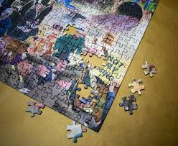
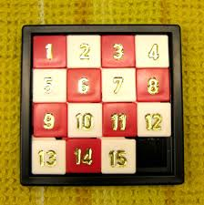

Outline
Introduction
Motivation • Problem Statement • Aim • Objectives
Literature Review
Difficulty of Tetris • Playing Tetris with Genetic Algorithms
Complexity Classes
If every single problem in NP can be reduced to a problem, that problem belongs in the NP-hard class [9]. Reductions involve converting inputs to a problem into inputs of another [8].
Reducing problem A into problem B tell us that problem B is at least as hard as problem A [8].
NP-hard
What is NP-complete?
Methodology
Defining the Rules • Genetic Algorithm Implementation • Evaluating Gameplay
Results and Discussion
Genetic Algorithm Results • Evaluating Final Weight Vector
Conclusion
Limitations • Future Work
Demo
Game • Bot

Slide 18
Outline
Introduction
Motivation • Problem Statement • Aim • Objectives
Literature Review
Difficulty of Tetris • Playing Tetris with Genetic Algorithms
Complexity Classes
NP-hard
NP
P
What is NP-complete?
NP-complete
Methodology
Defining the Rules • Genetic Algorithm Implementation • Evaluating Gameplay
Results and Discussion
Genetic Algorithm Results • Evaluating Final Weight Vector
Conclusion
Limitations • Future Work
Demo
Game • Bot

Slide 19
Outline
Introduction
Motivation • Problem Statement • Aim • Objectives
Literature Review
Difficulty of Tetris • Playing Tetris with Genetic Algorithms
Complexity Classes
What is NP-complete?
NP-complete
If a problem belongs in both the NP and NP-hard classes, it is NP-complete [8]. Therefore, these problems are the hardest in NP [7].
Methodology
Defining the Rules • Genetic Algorithm Implementation • Evaluating Gameplay
Results and Discussion
Genetic Algorithm Results • Evaluating Final Weight Vector
Conclusion
Limitations • Future Work
Demo
Game • Bot

Slide 20
Outline
Introduction
Motivation • Problem Statement • Aim • Objectives
Literature Review
Difficulty of Tetris • Playing Tetris with Genetic Algorithms
Complexity Classes
P = NP
Methodology
Defining the Rules • Genetic Algorithm Implementation • Evaluating Gameplay
Results and Discussion
Genetic Algorithm Results • Evaluating Final Weight Vector
Conclusion
Limitations • Future Work
Demo
Game • Bot

Slide 21
Outline
Introduction
Motivation • Problem Statement • Aim • Objectives
Literature Review
Difficulty of Tetris • Playing Tetris with Genetic Algorithms
Why Look at Non-traditional Approaches?
Addressing NP-completeness
According to [4]
Broadening set of acceptable solutions
Focus on average-case scenarios instead of worst-case scenarios.
NP-completeness implies that obtaining exact solutions are computationally intractable in a reasonable timeframe [10].
Methodology
Defining the Rules • Genetic Algorithm Implementation • Evaluating Gameplay
Results and Discussion
Genetic Algorithm Results • Evaluating Final Weight Vector
Conclusion
Limitations • Future Work
Demo
Game • Bot

Slide 22
Outline
Introduction
Motivation • Problem Statement • Aim • Objectives
Literature Review
Difficulty of Tetris • Playing Tetris with Genetic Algorithms
Why Look at Non-traditional Approaches?
Addressing NP-completeness
According to [10]
Broadening set of acceptable solutions
Focus on average-case scenarios instead of worst-case scenarios.
NP-completeness implies that obtaining exact solutions are computationally intractable in a reasonable timeframe.
Methodology
Defining the Rules • Genetic Algorithm Implementation • Evaluating Gameplay
Results and Discussion
Genetic Algorithm Results • Evaluating Final Weight Vector
Conclusion
Limitations • Future Work
Demo
Game • Bot

Slide 23
Outline
Introduction
Motivation • Problem Statement • Aim • Objectives
Literature Review
Difficulty of Tetris • Playing Tetris with Genetic Algorithms
What’s being optimised?
[5] and [6] uses an evaluation function that is the weighted sum of several numerical features present in a Tetris game. The weights on that function are being optimised.
Methodology
Defining the Rules • Genetic Algorithm Implementation • Evaluating Gameplay
Results and Discussion
Genetic Algorithm Results • Evaluating Final Weight Vector
Conclusion
Limitations • Future Work
Demo
Game • Bot

Slide 24
Outline
Introduction
Motivation • Problem Statement • Aim • Objectives
Literature Review
Difficulty of Tetris • Playing Tetris with Genetic Algorithms
How does it work?
Individuals are identified by their weight vectors.
In [5], each individual plays singleplayer games and uses the number of rows cleared as a fitness function.
In [6], the fitness function used is an arbitrary score set by the authors.
Methodology
Defining the Rules • Genetic Algorithm Implementation • Evaluating Gameplay
Results and Discussion
Genetic Algorithm Results • Evaluating Final Weight Vector
Conclusion
Limitations • Future Work
Demo
Game • Bot

Slide 25
Outline
Introduction
Motivation • Problem Statement • Aim • Objectives
Literature Review
Difficulty of Tetris • Playing Tetris with Genetic Algorithms
Methodology
Defining the Rules • Genetic Algorithm Implementation • Evaluating Gameplay
Results and Discussion
Genetic Algorithm Results • Evaluating Final Weight Vector
Conclusion
Limitations • Future Work
Demo
Game • Bot

Slide 26
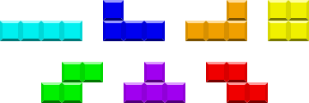
Outline
Introduction
Motivation • Problem Statement • Aim • Objectives
Literature Review
Difficulty of Tetris • Playing Tetris with Genetic Algorithms
Methodology
Defining the Rules • Genetic Algorithm Implementation • Evaluating Gameplay
Piece Sequence Generation
Seven Bag
Bag 1
Bag 2
Results and Discussion
Genetic Algorithm Results • Evaluating Final Weight Vector
Conclusion
Limitations • Future Work
Demo
Game • Bot

Slide 27
Outline
Introduction
Motivation • Problem Statement • Aim • Objectives
Literature Review
Difficulty of Tetris • Playing Tetris with Genetic Algorithms
Methodology
Defining the Rules • Genetic Algorithm Implementation • Evaluating Gameplay
Matrix Dimensions
2
20
10
Results and Discussion
Genetic Algorithm Results • Evaluating Final Weight Vector
Conclusion
Limitations • Future Work
Demo
Game • Bot

Slide 28
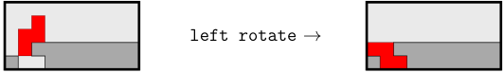
Outline
Introduction
Motivation • Problem Statement • Aim • Objectives
Literature Review
Difficulty of Tetris • Playing Tetris with Genetic Algorithms
Methodology
Defining the Rules • Genetic Algorithm Implementation • Evaluating Gameplay
Spins
Super Rotation System (SRS)
Official Rotation System in modern Tetris games.
Allows players to do special spins.
Results and Discussion
Genetic Algorithm Results • Evaluating Final Weight Vector
Conclusion
Limitations • Future Work
Demo
Game • Bot

Slide 29
Outline
Introduction
Motivation • Problem Statement • Aim • Objectives
Literature Review
Difficulty of Tetris • Playing Tetris with Genetic Algorithms
Methodology
Defining the Rules • Genetic Algorithm Implementation • Evaluating Gameplay
Attacks
Lines Cleared | Garbage Sent
1 | 0
2 | 1
3 | 2
4 | 4
Results and Discussion
Genetic Algorithm Results • Evaluating Final Weight Vector
Conclusion
Limitations • Future Work
Demo
Game • Bot

Slide 30
Outline
Introduction
Motivation • Problem Statement • Aim • Objectives
Literature Review
Difficulty of Tetris • Playing Tetris with Genetic Algorithms
Methodology
Defining the Rules • Genetic Algorithm Implementation • Evaluating Gameplay
Attacks
T-Spins
Results and Discussion
Genetic Algorithm Results • Evaluating Final Weight Vector
Conclusion
Limitations • Future Work
Demo
Game • Bot

Slide 31
Outline
Introduction
Motivation • Problem Statement • Aim • Objectives
Literature Review
Difficulty of Tetris • Playing Tetris with Genetic Algorithms
Methodology
Defining the Rules • Genetic Algorithm Implementation • Evaluating Gameplay
Attacks
T-Spins
Results and Discussion
Genetic Algorithm Results • Evaluating Final Weight Vector
Conclusion
Limitations • Future Work
Demo
Game • Bot

Slide 32
Outline
Introduction
Motivation • Problem Statement • Aim • Objectives
Literature Review
Difficulty of Tetris • Playing Tetris with Genetic Algorithms
Methodology
Defining the Rules • Genetic Algorithm Implementation • Evaluating Gameplay
Attacks
T-Spins
T-spins send double the lines that they clear.
Results and Discussion
Genetic Algorithm Results • Evaluating Final Weight Vector
Conclusion
Limitations • Future Work
Demo
Game • Bot

Slide 33
Outline
Introduction
Motivation • Problem Statement • Aim • Objectives
Literature Review
Difficulty of Tetris • Playing Tetris with Genetic Algorithms
Methodology
Defining the Rules • Genetic Algorithm Implementation • Evaluating Gameplay
Attacks
Back-to-back (B2B)
Back-to-back encourages players to continuously play for Tetrises and T-spins.
Cumulatively adds 1 to garbage sent, e.g. performing a Tetris after 9B2B will send 4 lines (from Tetris) + 9 lines (from B2B)
Results and Discussion
Genetic Algorithm Results • Evaluating Final Weight Vector
Conclusion
Limitations • Future Work
Demo
Game • Bot

Slide 34
Outline
Introduction
Motivation • Problem Statement • Aim • Objectives
Literature Review
Difficulty of Tetris • Playing Tetris with Genetic Algorithms
Methodology
Defining the Rules • Genetic Algorithm Implementation • Evaluating Gameplay
Attacks
Combos
Combo | 0 | 1 | 2 | 3 | 4 | 5 | 6 | 7 | 8 | 9 | 10 | 11+
Additional Garbage | 0 | 0 | 1 | 1 | 2 | 2 | 3 | 3 | 4 | 4 | 4 | 5
Results and Discussion
Genetic Algorithm Results • Evaluating Final Weight Vector
Conclusion
Limitations • Future Work
Demo
Game • Bot

Slide 35
Outline
Introduction
Motivation • Problem Statement • Aim • Objectives
Literature Review
Difficulty of Tetris • Playing Tetris with Genetic Algorithms
Methodology
Defining the Rules • Genetic Algorithm Implementation • Evaluating Gameplay
Attacks
Perfect Clears
Clearing the whole matrix sends 6 lines.
Results and Discussion
Genetic Algorithm Results • Evaluating Final Weight Vector
Conclusion
Limitations • Future Work
Demo
Game • Bot

Slide 36
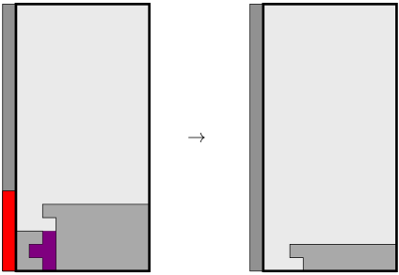
Outline
Introduction
Motivation • Problem Statement • Aim • Objectives
Literature Review
Difficulty of Tetris • Playing Tetris with Genetic Algorithms
Methodology
Defining the Rules • Genetic Algorithm Implementation • Evaluating Gameplay
Attacks
Stored Attacks
System that prevents garbage from spawning in player’s board as long as lines are being cleared. Players can cancelled stored attacks.
Results and Discussion
Genetic Algorithm Results • Evaluating Final Weight Vector
Conclusion
Limitations • Future Work
Demo
Game • Bot

Slide 37
Outline
Introduction
Motivation • Problem Statement • Aim • Objectives
Literature Review
Difficulty of Tetris • Playing Tetris with Genetic Algorithms
Methodology
Defining the Rules • Genetic Algorithm Implementation • Evaluating Gameplay
Gravity
No gravity
Focused on quality of decisions being made, not the speed at which it is being made.
Allows players to think before placing pieces.
Results and Discussion
Genetic Algorithm Results • Evaluating Final Weight Vector
Conclusion
Limitations • Future Work
Demo
Game • Bot

Slide 38
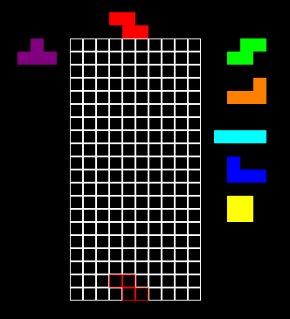
Outline
Introduction
Motivation • Problem Statement • Aim • Objectives
Literature Review
Difficulty of Tetris • Playing Tetris with Genetic Algorithms
Methodology
Defining the Rules • Genetic Algorithm Implementation • Evaluating Gameplay
Additional Features
Hold
Allow player to swap out current piece with held piece.
5 piece lookahead
Allow players to plan 5 pieces ahead.
Results and Discussion
Genetic Algorithm Results • Evaluating Final Weight Vector
Conclusion
Limitations • Future Work
Demo
Game • Bot

Slide 39
Outline
Introduction
Motivation • Problem Statement • Aim • Objectives
Literature Review
Difficulty of Tetris • Playing Tetris with Genetic Algorithms
Methodology
Defining the Rules • Genetic Algorithm Implementation • Evaluating Gameplay
Representation
Bot behaviour is determined by a weighted feature evaluation function. The following are the considered features:
Pile height
Hole count
Column transitions
Row transitions
Hole depth
Cumulative well depth
Row holes
Line clears
Attack
Back-to-back (B2B)
Results and Discussion
Genetic Algorithm Results • Evaluating Final Weight Vector
Conclusion
Limitations • Future Work
Demo
Game • Bot

Slide 40
Outline
Introduction
Motivation • Problem Statement • Aim • Objectives
Literature Review
Difficulty of Tetris • Playing Tetris with Genetic Algorithms
Methodology
Defining the Rules • Genetic Algorithm Implementation • Evaluating Gameplay
Representation
Each individual in the population is represented by a weight vector, with each weight corresponding to one of the features. Weights are limited to be within the range of -1 to 1.
0.4 | -1 | 1 | -0.3 | 0.2 | 0.5 | -0.7 | -1 | -0.3 | 0.4
Results and Discussion
Genetic Algorithm Results • Evaluating Final Weight Vector
Conclusion
Limitations • Future Work
Demo
Game • Bot

Slide 41
Outline
Introduction
Motivation • Problem Statement • Aim • Objectives
Literature Review
Difficulty of Tetris • Playing Tetris with Genetic Algorithms
Methodology
Defining the Rules • Genetic Algorithm Implementation • Evaluating Gameplay
Initial population
Calculate Fitness
Selection
No
Crossover
Mutation
Is Termination Criteria Satisfied?
Yes
Results and Discussion
Genetic Algorithm Results • Evaluating Final Weight Vector
Conclusion
Limitations • Future Work
Demo
Game • Bot

Slide 42
Outline
Introduction
Motivation • Problem Statement • Aim • Objectives
Literature Review
Difficulty of Tetris • Playing Tetris with Genetic Algorithms
Methodology
Defining the Rules • Genetic Algorithm Implementation • Evaluating Gameplay
Initial population
Population size = 6
Generates random weights.
Results and Discussion
Genetic Algorithm Results • Evaluating Final Weight Vector
Conclusion
Limitations • Future Work
Demo
Game • Bot

Slide 43
Outline
Introduction
Motivation • Problem Statement • Aim • Objectives
Literature Review
Difficulty of Tetris • Playing Tetris with Genetic Algorithms
Methodology
Defining the Rules • Genetic Algorithm Implementation • Evaluating Gameplay
Initial population
Calculate Fitness
Selection
No
Crossover
Mutation
Is Termination Criteria Satisfied?
Yes
Results and Discussion
Genetic Algorithm Results • Evaluating Final Weight Vector
Conclusion
Limitations • Future Work
Demo
Game • Bot

Slide 44
Outline
Introduction
Motivation • Problem Statement • Aim • Objectives
Literature Review
Difficulty of Tetris • Playing Tetris with Genetic Algorithms
Methodology
Defining the Rules • Genetic Algorithm Implementation • Evaluating Gameplay
Calculate Fitness
Let each individual play against its peers with a maximum piece limit.
Fitness calculated with equation below.
$Fitness=Winrate+Average Attack Efficiency$ + $\frac{1}{Max Pieces} ∗Pieces Placed$
Results and Discussion
Genetic Algorithm Results • Evaluating Final Weight Vector
Conclusion
Limitations • Future Work
Demo
Game • Bot

Slide 45
Outline
Introduction
Motivation • Problem Statement • Aim • Objectives
Literature Review
Difficulty of Tetris • Playing Tetris with Genetic Algorithms
Methodology
Defining the Rules • Genetic Algorithm Implementation • Evaluating Gameplay
Initial population
Calculate Fitness
Selection
No
Crossover
Mutation
Is Termination Criteria Satisfied?
Yes
Results and Discussion
Genetic Algorithm Results • Evaluating Final Weight Vector
Conclusion
Limitations • Future Work
Demo
Game • Bot

Slide 46
Outline
Introduction
Motivation • Problem Statement • Aim • Objectives
Literature Review
Difficulty of Tetris • Playing Tetris with Genetic Algorithms
Methodology
Defining the Rules • Genetic Algorithm Implementation • Evaluating Gameplay
Selection
Rank-based selection.
Example:
Individual | Fitness | Rank | Probability
1 | 0.03 | 3 | 0.1905
2 | 0.1 | 2 | 0.2381
3 | 0.05 | 4 | 0.1429
4 | 0.002 | 6 | 0.0476
5 | 0.067 | 5 | 0.0952
6 | 0.3 | 1 | 0.2857
Results and Discussion
Genetic Algorithm Results • Evaluating Final Weight Vector
Conclusion
Limitations • Future Work
Demo
Game • Bot

Slide 47
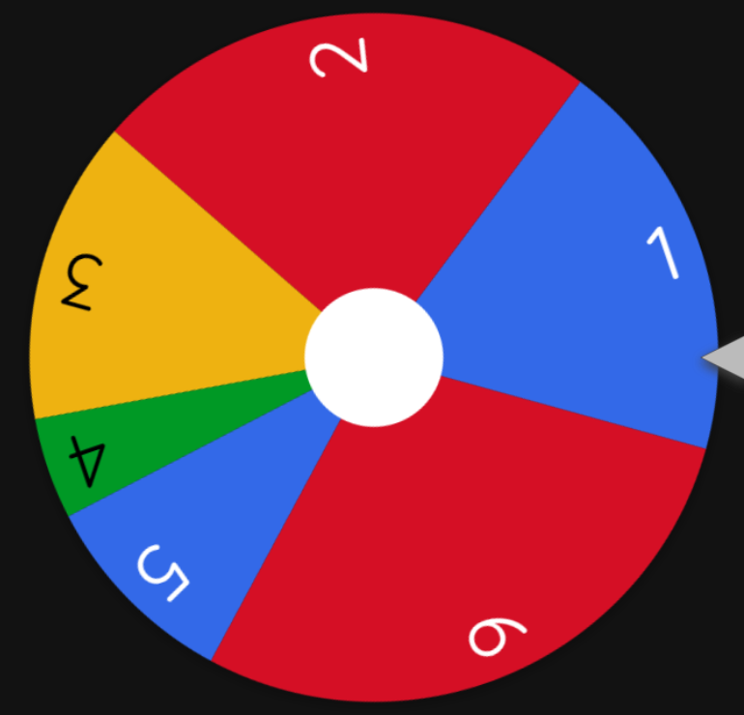
Outline
Introduction
Motivation • Problem Statement • Aim • Objectives
Literature Review
Difficulty of Tetris • Playing Tetris with Genetic Algorithms
Methodology
Defining the Rules • Genetic Algorithm Implementation • Evaluating Gameplay
Selection
Rank-based selection.
Example:
Individual | Probability
1 | 0.1905
2 | 0.2381
3 | 0.1429
4 | 0.0476
5 | 0.0952
6 | 0.2857
Results and Discussion
Genetic Algorithm Results • Evaluating Final Weight Vector
Conclusion
Limitations • Future Work
Demo
Game • Bot

Slide 48
Outline
Introduction
Motivation • Problem Statement • Aim • Objectives
Literature Review
Difficulty of Tetris • Playing Tetris with Genetic Algorithms
Methodology
Defining the Rules • Genetic Algorithm Implementation • Evaluating Gameplay
Initial population
Calculate Fitness
Selection
No
Crossover
Mutation
Is Termination Criteria Satisfied?
Yes
Results and Discussion
Genetic Algorithm Results • Evaluating Final Weight Vector
Conclusion
Limitations • Future Work
Demo
Game • Bot

Slide 49
Outline
Introduction
Motivation • Problem Statement • Aim • Objectives
Literature Review
Difficulty of Tetris • Playing Tetris with Genetic Algorithms
Methodology
Defining the Rules • Genetic Algorithm Implementation • Evaluating Gameplay
Crossover
Parent 1
0.4 | -1 | 1 | -0.3 | 0.2 | 0.5 | -0.7 | -1 | -0.3 | 0.4
+
Parent 2
-0.2 | 0.6 | -1 | 0.5 | 0.7 | -0.2 | -0.9 | 1 | 0.7 | 0.9
Child 1
0.4 | -1 | -1 | -0.3 | 0.7 | -0.2 | -0.7 | 1 | -0.3 | 0.4
Child 2
-0.2 | 0.6 | 1 | 0.5 | 0.2 | 0.5 | -0.9 | -1 | 0.7 | 0.9
Results and Discussion
Genetic Algorithm Results • Evaluating Final Weight Vector
Conclusion
Limitations • Future Work
Demo
Game • Bot

Slide 50
Outline
Introduction
Motivation • Problem Statement • Aim • Objectives
Literature Review
Difficulty of Tetris • Playing Tetris with Genetic Algorithms
Methodology
Defining the Rules • Genetic Algorithm Implementation • Evaluating Gameplay
Initial population
Calculate Fitness
Selection
No
Crossover
Mutation
Is Termination Criteria Satisfied?
Yes
Results and Discussion
Genetic Algorithm Results • Evaluating Final Weight Vector
Conclusion
Limitations • Future Work
Demo
Game • Bot

Slide 51
Outline
Introduction
Motivation • Problem Statement • Aim • Objectives
Literature Review
Difficulty of Tetris • Playing Tetris with Genetic Algorithms
Methodology
Defining the Rules • Genetic Algorithm Implementation • Evaluating Gameplay
Mutation
Each chromosome of the individual has a 30% chance of mutation*.
0.4 | -1 | -1 | -0.3 | 0.7 | -0.2 | -0.7 | 1 | -0.3 | 0.4
Mutation randomly adds a value between -0.5 and 0.5 to that chromosome.
0.4 | -1 | -1 | -0.498 | 0.7 | -0.2 | -0.7 | -0.785 | -0.3 | -0.008
*30% chance of mutation decreases with each iteration to promote exploitation over exploration
Results and Discussion
Genetic Algorithm Results • Evaluating Final Weight Vector
Conclusion
Limitations • Future Work
Demo
Game • Bot

Slide 52
Outline
Introduction
Motivation • Problem Statement • Aim • Objectives
Literature Review
Difficulty of Tetris • Playing Tetris with Genetic Algorithms
Methodology
Defining the Rules • Genetic Algorithm Implementation • Evaluating Gameplay
Initial population
Calculate Fitness
Selection
No
Crossover
Mutation
Is Termination Criteria Satisfied?
Yes
Results and Discussion
Genetic Algorithm Results • Evaluating Final Weight Vector
Conclusion
Limitations • Future Work
Demo
Game • Bot

Slide 53
Outline
Introduction
Motivation • Problem Statement • Aim • Objectives
Literature Review
Difficulty of Tetris • Playing Tetris with Genetic Algorithms
Methodology
Defining the Rules • Genetic Algorithm Implementation • Evaluating Gameplay
Is Termination Criteria Satisfied?
Convergence reached, or
Max iterations reached (100 iterations)
Results and Discussion
Genetic Algorithm Results • Evaluating Final Weight Vector
Conclusion
Limitations • Future Work
Demo
Game • Bot

Slide 54

Outline
Introduction
Motivation • Problem Statement • Aim • Objectives
Literature Review
Difficulty of Tetris • Playing Tetris with Genetic Algorithms
Methodology
Defining the Rules • Genetic Algorithm Implementation • Evaluating Gameplay
Evaluating Attack Efficiency
Let bot play in a singleplayer game with limited pieces.
Calculate attack efficiency using the formula below. $Attack Efficiency= \frac{Total Attack}{Total Pieces Placed}$
Results and Discussion
Genetic Algorithm Results • Evaluating Final Weight Vector
Conclusion
Limitations • Future Work
Demo
Game • Bot

Slide 55
Outline
Introduction
Motivation • Problem Statement • Aim • Objectives
Literature Review
Difficulty of Tetris • Playing Tetris with Genetic Algorithms
Methodology
Defining the Rules • Genetic Algorithm Implementation • Evaluating Gameplay
Evaluating Survivability
Let bot play in a singleplayer minigame known as survival.
Garbage spawns every time the bot places a piece.
A bot with high survivability should be able to place more pieces before topping out.
Results and Discussion
Genetic Algorithm Results • Evaluating Final Weight Vector
Conclusion
Limitations • Future Work
Demo
Game • Bot

Slide 56
Outline
Introduction
Motivation • Problem Statement • Aim • Objectives
Literature Review
Difficulty of Tetris • Playing Tetris with Genetic Algorithms
Methodology
Defining the Rules • Genetic Algorithm Implementation • Evaluating Gameplay
Results and Discussion
Genetic Algorithm Results • Evaluating Final Weight Vector
Conclusion
Limitations • Future Work
Demo
Game • Bot

Slide 57
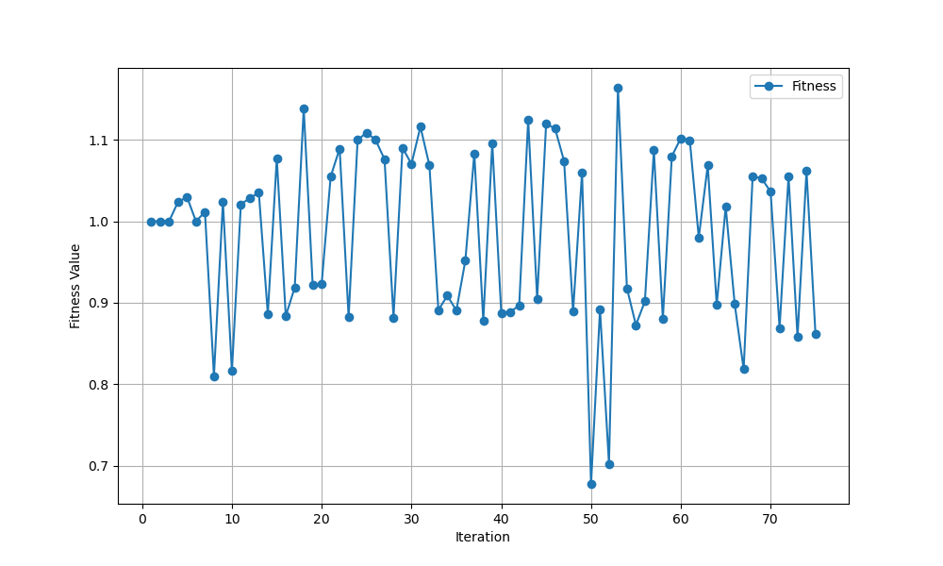
Outline
Introduction
Motivation • Problem Statement • Aim • Objectives
Literature Review
Difficulty of Tetris • Playing Tetris with Genetic Algorithms
Methodology
Defining the Rules • Genetic Algorithm Implementation • Evaluating Gameplay
Results and Discussion
Genetic Algorithm Results • Evaluating Final Weight Vector
Conclusion
Limitations • Future Work
Demo
Game • Bot

Slide 58
Outline
Introduction
Motivation • Problem Statement • Aim • Objectives
Literature Review
Difficulty of Tetris • Playing Tetris with Genetic Algorithms
Methodology
Defining the Rules • Genetic Algorithm Implementation • Evaluating Gameplay
Results and Discussion
Genetic Algorithm Results • Evaluating Final Weight Vector
Features | Iteration Weights
 | 1 | 20 | 50 | 75
Pile Height | 0.21960 | 0.03682 | -0.88214 | -0.92416
Hole Count | 0.42001 | -0.35693 | 0.18129 | -0.63448
Column Transitions | -0.67151 | -0.54675 | -1.00000 | -1.00000
Row Transitions | 0.44741 | -0.94860 | -0.06702 | -0.75189
Hole Depth | -0.95575 | -0.45945 | -0.51573 | 0.02639
Cumulative Well Depth | -0.50302 | -0.16005 | -0.56181 | -0.70165
Row Hole | -0.50031 | 0.00446 | -0.17533 | 0.07719
Line Clears | 0.37663 | -1.00000 | -0.85188 | 0.48772
Attack | -0.51747 | -0.83629 | -1.00000 | -0.36715
Back-to-back | -0.30431 | 0.28046 | 0.98861 | 1.00000
Conclusion
Limitations • Future Work
Demo
Game • Bot

Slide 59
Outline
Introduction
Motivation • Problem Statement • Aim • Objectives
Literature Review
Difficulty of Tetris • Playing Tetris with Genetic Algorithms
Methodology
Defining the Rules • Genetic Algorithm Implementation • Evaluating Gameplay
Results and Discussion
Genetic Algorithm Results • Evaluating Final Weight Vector
Evaluating Attack Efficiency
Iteration Individuals | 1 | 20 | 50 | 75
Attack Efficiency (5 d.p.) | 0.03984 | 0.09307 | 0.07723 | 0.03564
Conclusion
Limitations • Future Work
Demo
Game • Bot

Slide 60
Outline
Introduction
Motivation • Problem Statement • Aim • Objectives
Literature Review
Difficulty of Tetris • Playing Tetris with Genetic Algorithms
Methodology
Defining the Rules • Genetic Algorithm Implementation • Evaluating Gameplay
Results and Discussion
Genetic Algorithm Results • Evaluating Final Weight Vector
Evaluating Survivability
Iteration Individuals | 1 | 20 | 50 | 75
Tetrominos Placed | 24.7 | 35.6 | 36.3 | 36.8
Conclusion
Limitations • Future Work
Demo
Game • Bot

Slide 61
Outline
Introduction
Motivation • Problem Statement • Aim • Objectives
Literature Review
Difficulty of Tetris • Playing Tetris with Genetic Algorithms
Methodology
Defining the Rules • Genetic Algorithm Implementation • Evaluating Gameplay
Results and Discussion
Genetic Algorithm Results • Evaluating Final Weight Vector
Conclusion
Limitations • Future Work
Demo
Game • Bot

Slide 62
Outline
Introduction
Motivation • Problem Statement • Aim • Objectives
Literature Review
Difficulty of Tetris • Playing Tetris with Genetic Algorithms
Methodology
Defining the Rules • Genetic Algorithm Implementation • Evaluating Gameplay
Results and Discussion
Genetic Algorithm Results • Evaluating Final Weight Vector
Conclusion
Limitations • Future Work
Bot
Unable to fully utilise hold
Unable to fully utilise 5-piece lookahead
Unable to do certain spins.
Fitness Function
Can be further improved (win-rate makes things very turbulent).
Demo
Game • Bot

Slide 63
Outline
Introduction
Motivation • Problem Statement • Aim • Objectives
Literature Review
Difficulty of Tetris • Playing Tetris with Genetic Algorithms
Methodology
Defining the Rules • Genetic Algorithm Implementation • Evaluating Gameplay
Results and Discussion
Genetic Algorithm Results • Evaluating Final Weight Vector
Conclusion
Limitations • Future Work
Incorporate multi-piece lookahead.
Larger placement trees.
Other optimisation approaches.
Demo
Game • Bot

Slide 64
Outline
Introduction
Motivation • Problem Statement • Aim • Objectives
Literature Review
Difficulty of Tetris • Playing Tetris with Genetic Algorithms
Methodology
Defining the Rules • Genetic Algorithm Implementation • Evaluating Gameplay
Results and Discussion
Genetic Algorithm Results • Evaluating Final Weight Vector
Conclusion
Limitations • Future Work
Demo
Game • Bot

Slide 65
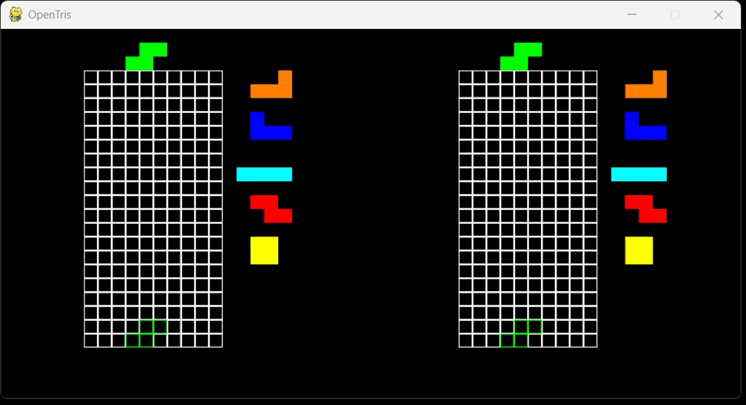
Outline
Introduction
Motivation • Problem Statement • Aim • Objectives
Literature Review
Difficulty of Tetris • Playing Tetris with Genetic Algorithms
Methodology
Defining the Rules • Genetic Algorithm Implementation • Evaluating Gameplay
Results and Discussion
Genetic Algorithm Results • Evaluating Final Weight Vector
Conclusion
Limitations • Future Work
Demo
Game • Bot

Slide 66
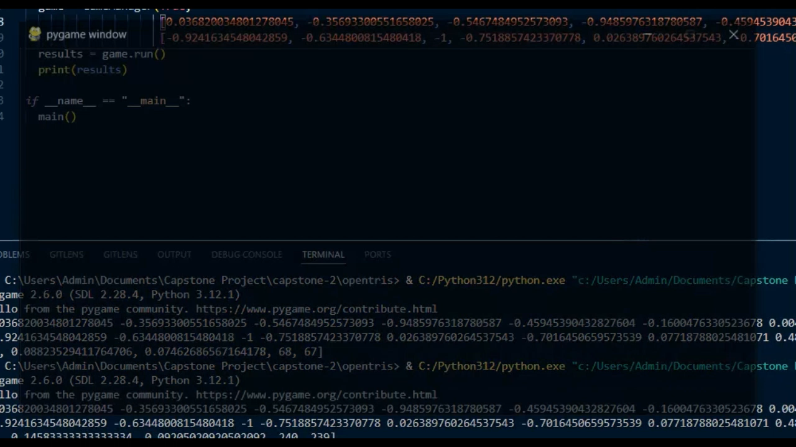
Outline
Introduction
Motivation • Problem Statement • Aim • Objectives
Literature Review
Difficulty of Tetris • Playing Tetris with Genetic Algorithms
Methodology
Defining the Rules • Genetic Algorithm Implementation • Evaluating Gameplay
Results and Discussion
Genetic Algorithm Results • Evaluating Final Weight Vector
Conclusion
Limitations • Future Work
Demo
Game • Bot

Slide 67
Outline
Introduction
Motivation • Problem Statement • Aim • Objectives
Literature Review
Difficulty of Tetris • Playing Tetris with Genetic Algorithms
Methodology
Defining the Rules • Genetic Algorithm Implementation • Evaluating Gameplay
Results and Discussion
Genetic Algorithm Results • Evaluating Final Weight Vector
Conclusion
Limitations • Future Work
Demo
Game • Bot
Explanation
Attack Efficiency (Left): 0.10670443814919736
Attack Efficiency (Right): 0.08034026465028356
Bot on the left has higher efficiency, plays more aggressively, but still lost.
Bot on the right was more focused on survival.

Slide 68
References
Introduction
Motivation • Problem Statement • Aim • Objectives
Literature Review
Difficulty of Tetris • Playing Tetris with Genetic Algorithms
Methodology
Defining the Rules • Genetic Algorithm Implementation • Evaluating Gameplay
Results and Discussion
Genetic Algorithm Results • Evaluating Final Weight Vector
Conclusion
Limitations • Future Work
Demo
Game • Bot
[1] Veronica Lesch et al. “A Case Study of Vehicle Route Optimization.” In: CorRR abs/2111.09087 (2021).
[2] Jeffrey D. Ulman. “NP-complete scheduling problems”. In: Journal of Computer and System sciences
10.3 (1975), pp. 384-393
[3] Jeff Arle and Kristen Carlson. “Medical diagnosis and treatment is NP-complete”.
In: Journal of Experimental & Theoretical Artificial Intelligence 33 (Mar. 2020),
pp. 1–16. doi: 10.1080/0952813X.2020.1737581
[4] Erik D. Demaine, Susan Hohenberger, and David Liben-Nowell. “Tetris is Hard,
Even to Approximate”. In: Computing and Combinatorics. Ed. by Tandy Warnow
and Binhai Zhu. Berlin, Heidelberg: Springer Berlin Heidelberg, 2003, pp. 351–363.
isbn: 978-3-540-45071-9.
[5] Darrell Whitley and Timothy Starkweather. “Genitor II: A distributed genetic
algorithm”. In: Journal of Experimental & Theoretical Artificial Intelligence 2.3
(1990), pp. 189–214.
[6] Jason Lewis. “Playing Tetris with Genetic Algorithms”. In: 2015. url:
https://api.semanticscholar.org/CorpusID:17416568.

Slide 69
References
Introduction
Motivation • Problem Statement • Aim • Objectives
Literature Review
Difficulty of Tetris • Playing Tetris with Genetic Algorithms
Methodology
Defining the Rules • Genetic Algorithm Implementation • Evaluating Gameplay
Results and Discussion
Genetic Algorithm Results • Evaluating Final Weight Vector
Conclusion
Limitations • Future Work
Demo
Game • Bot
[7] S. Arora and B. Barak. Computational Complexity: A Modern Approach. Cambridge University Press, 2009.
isbn: 9780521424264.
[8] MIT OpenCourseWare. NP-Completeness. 6.046J: Design and Analysis on Algorithms, Massachusetts Institute of
Technology. 2015.
url: https://ocw.mit.edu/courses/6-046j-design-and-analysis-of-algorithms-spring-
2015/resources/mit6_046js15_lec16/.
[9] Michael Sipser. In: Introduction to the Theory of Computation. Cengage Learning, 2013.
[10] Oded Goldreich. “Computational complexity: a conceptual perspective”. In: SIGACT News 39.3 (Sept. 2008).
issn: 0163-5700. doi: 10.1145/1412700.1412710. url: https://doi.org/10.1145/1412700.1412710.

Slide 70
Q&A

